Slide 1
Greenville County Indicators 2017
Prepared by: Kara Davis, M.Ed.
Director, Metropolitan Studies Institute
University of South Carolina Upstate
Resident segregation and income maps developed by Natalia C. Rosario, MCRP

Slide 2
Demographics

Slide 3
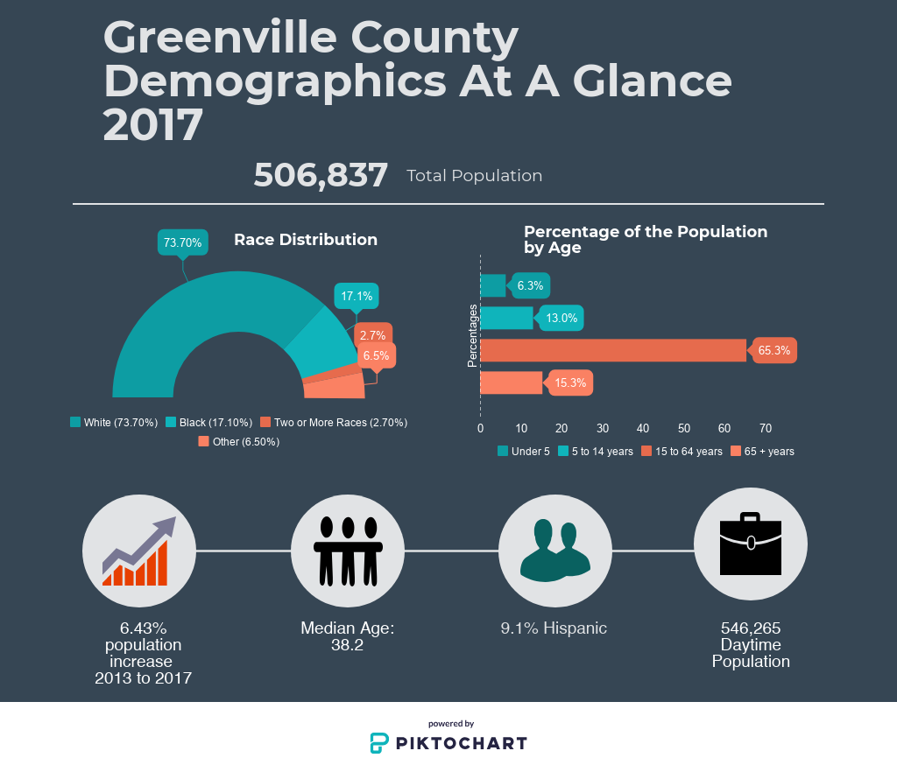

Slide 4
Greenville County Population Characteristics
 | 2013 | 2014 | 2015 | 2016 | 2017
Total Population | 474,266 | 482,752 | 491,863 | 498,766 | 506,837
Percent Male | 48.7% | 48.7% | 48.6% | 48.5% | 48.5%
Percent Female | 51.3% | 51.3% | 51.4% | 51.5% | 51.5%
Age Ranges
Under 5 | 6.5% | 6.4% | 6.4% | 6.4% | 6.3%
5 to 14 years | 13.3% | 13.2% | 13.2% | 13.0% | 13.0%
15 to 64 years | 66.3% | 66.0% | 65.8% | 65.4% | 65.3%
65 + years | 13.9% | 14.4% | 14.6% | 15.0% | 15.3%
Median Age | 37.8 | 37.9 | 37.8 | 38.1 | 38.2
Race/Ethnicity
White | 76.9% | 76.4% | 75.0% | 74.6% | 73.7%
Black | 18.3% | 18.2% | 18.1% | 18.3% | 17.1%
Two or More | 1.4% | 2.2% | 2.5% | 2.1% | 2.7%
Hispanic or Latino (any race) | 8.7% | 8.8% | 8.8% | 9.0% | 9.1%
Notes:
Like the trends observed nationally, the percentage of the population 65+ is the fastest growing portion of the population.
Greenville County population has increased by 32,571 individuals from 2013 to 2017
Source: United States Census Bureau, 2013-2017

Slide 5
Notes:
Source: United States Census Bureau, 2013-2017

Slide 6
Notes:
5 year growth rate outpacing Richland and State rates.
Source: United States Census Bureau, 2017

Slide 7
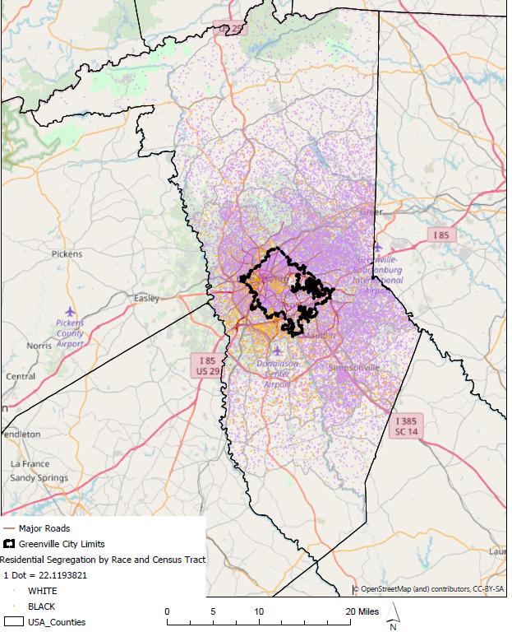
Resident Segregation, Greenville County
Notes:
1 dot = 5 individuals
Purple dots represent White residents
Orange dots represent Black residents
Source: United States Census Bureau, 2017

Slide 8
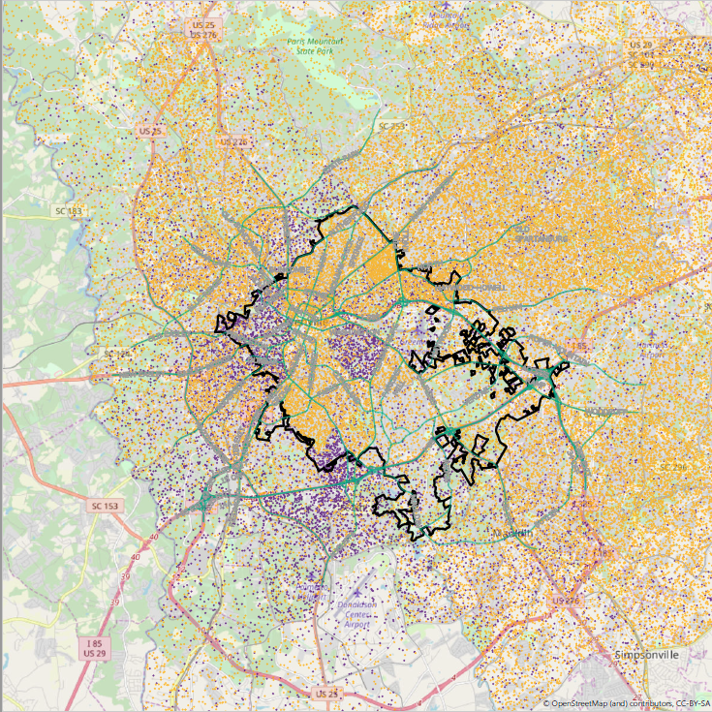
Resident Segregation, City of Greenville
Notes:
1 dot = 5 individuals
Purple dots represent White residents
Orange dots represent Black residents
Source: United States Census Bureau, 2017

Slide 9
Education

Slide 10
3rd Grade English Language Arts (ELA)

Slide 11
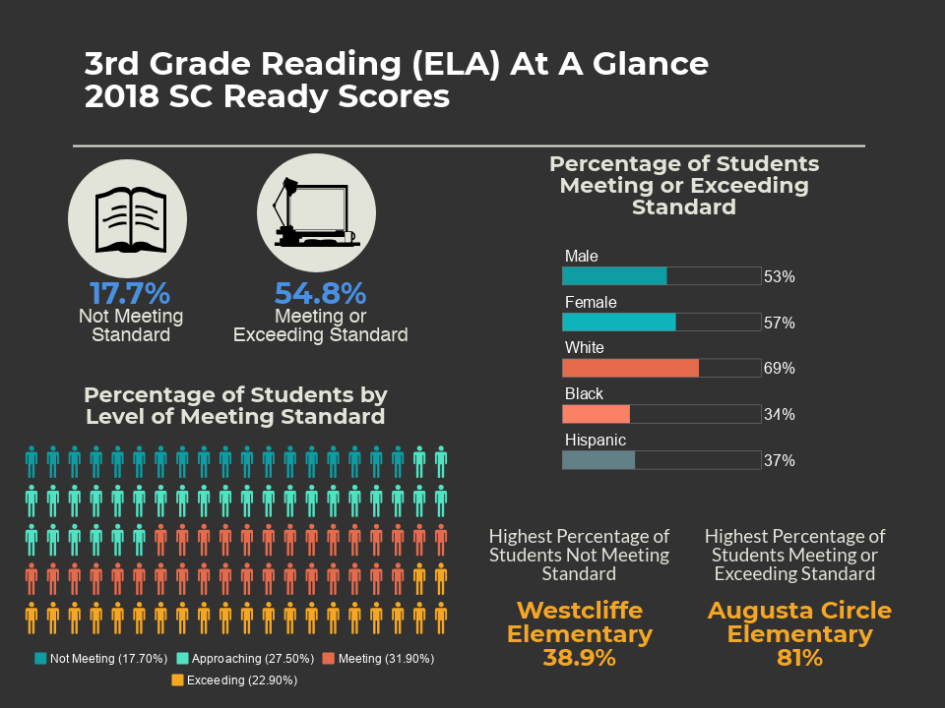
Notes:
Students who fall behind in reading at grade level are at a higher risk of not graduating high school and have long-term impacts on their future social and economic statuses. Reading proficiency by the end of 3rd grade is a strong predictor of a child’s educational development and a make-or-break benchmark. Prior to 3rd grade, children are “learning to read” whereas 4th grade and beyond is “reading to learn.” After 3rd grade, textbooks and other reading materials are no longer simple primers, but rather actual texts containing material that children must master before moving forward. According to the Children’s Reading Foundation, almost half of the printed 4th grade materials is incomprehensible to children who read below level.

Slide 12
Percentages on the graphs are 2018 data
Notes:
17.7% of all 3rd graders in Greenville County did not meet the ELA standard in 2018, and, unless they meet certain requirements, will be required to be held back the following academic year.
Greenville County has a higher percentage of 3rd graders meeting or exceeding the standard than the peer counties and the state average.
Source: South Carolina Department of Education, 2016-2018

Slide 13
Percentage of Students Not Meeting 3rd Grade ELA Standard by School

Slide 14
Notes:
Source: South Carolina Department of Education, 2018

Slide 15
Notes:
Source: South Carolina Department of Education, 2018

Slide 16
Notes:
Source: South Carolina Department of Education, 2018

Slide 17
Percentage of Students Meeting and Exceeding 3rd Grade ELA Standard by School

Slide 18
Notes:
Source: South Carolina Department of Education, 2018

Slide 19
Notes:
Source: South Carolina Department of Education, 2018

Slide 20
Notes:
Source: South Carolina Department of Education, 2018

Slide 21
8th Grade Math

Slide 22
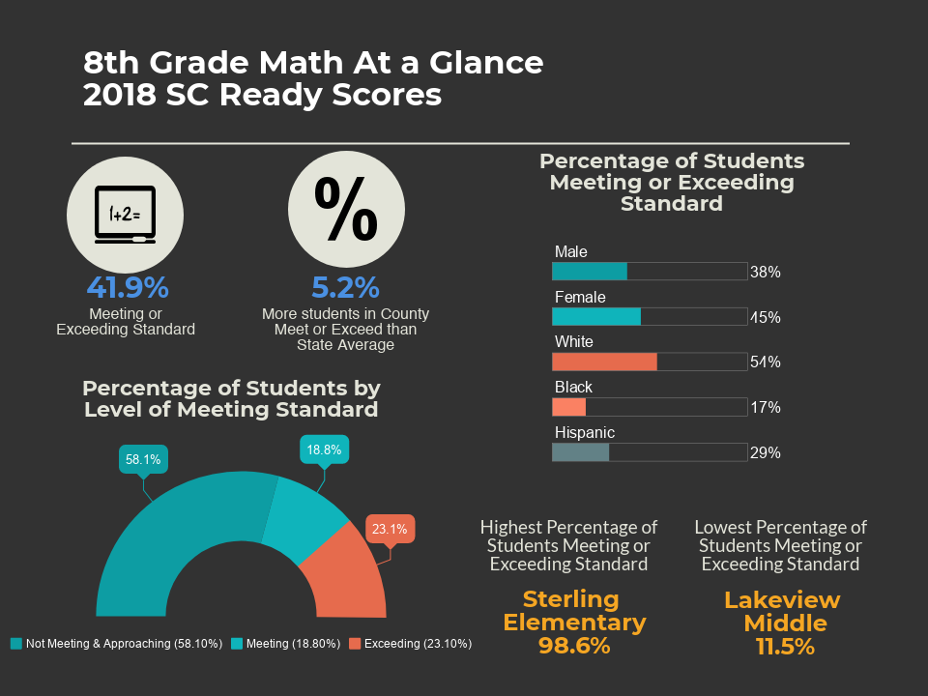
Notes:
Math proficiency and taking higher-level mathematics courses in high school are correlated to high school graduation and are considered gatekeeping courses for student’s enrollment & completion of college. Higher-level math courses emphasize higher order thinking and complex problem-solving skills, both of which are important beyond the academic realm. Individuals who transition into the workforce with limited mathematic skills are likely to find functioning in society challenging, as basic arithmetic skills are required for everyday functions.

Slide 23
Percentages on graph represent 2018 numbers
Notes:
Female students and those who are white preformed better in 8th grade math than their counterparts in 2018, and have consistently performed better over the past few years.
Source: South Carolina Department of Education, 2016-2018

Slide 24
Notes:
Source: South Carolina Department of Education, 2018

Slide 25
Notes:
Source: South Carolina Department of Education, 2018

Slide 26
High School Outcomes

Slide 27
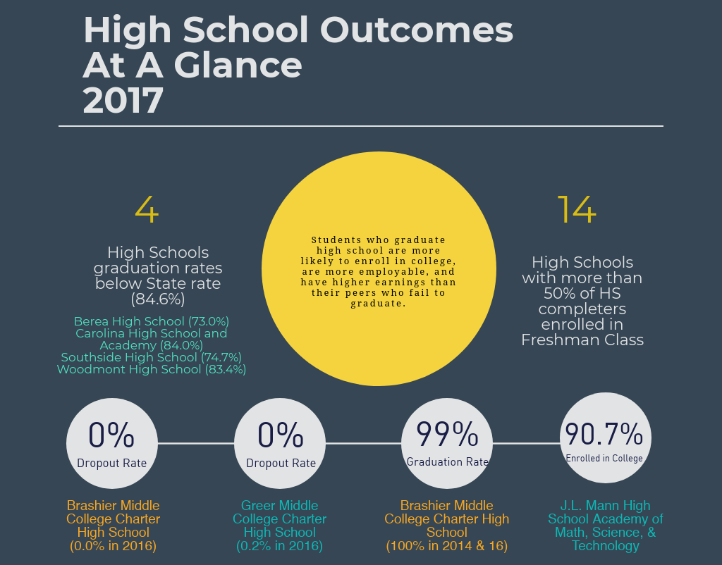
Notes:
The National Center for Education Statistics reported that during the 2015-2016 school year, the national adjusted cohort graduation rate (ACGR) for public high school students was 84%. Iowa had the highest graduation rate at 91% and the District of Columbia had the lowest at 69%. South Carolina tied for 29th out of 50 (49 States plus the District of Columbia) with an ACGR of 83%*. The adjusted cohort graduate rate is the number of students who graduate in 4 years with a regular high school diploma, accounting for students who enter and leave the cohort between 9th and 12th grade, divided by the number of students who form the adjusted cohort for the graduating class.
*Alabama’s ACGR did not meet the reporting standards and no rate is available.
As with the previous measures, there are disparities by race or ethnicity. Nationally during the 2015-2016 academic year, 12% of white students who were part of the adjusted cohort did not graduate high school, whereas the rate for black students was twice as high at 24% and the rate for Hispanic students was 21%.
National Center for Education Statistics

Slide 28
Dropout Rates Greenville County High Schools 2016 and 2017
 | 2016 Dropout Rate | 2017 Dropout Rate
Berea High School | 5.5% | 4.3%
Blue Ridge High School | 1.8% | 2.9%
Brashier Middle College Charter High School | 0.0% | 0.0%
Carolina High School and Academy | 4.5% | 6.2%
Eastside High School | 1.7% | 1.8%
Greenville High School Academy of Law, Finance and Business | 3.9% | 3.4%
Greer High School | 4.7% | 3.8%
Greer Middle College Charter High School | 0.2% | 0.0%
Hillcrest High School | 2.9% | 2.6%
J. L. Mann High School Academy of Math, Science, and Technology | 1.7% | 2.0%
Legacy Early College | 1.6% | 0.0%
Mauldin High School | 0.9% | 1.5%
Riverside High School | 1.4% | 1.4%
Southside High School | 4.1% | 8.8%
Travelers Rest High School | 6.8% | 4.8%
Wade Hampton High School | 1.2% | 1.8%
Woodmont High School | 4.1% | 2.7%
Notes:
Source: South Carolina Department of Education, 2016-2017

Slide 29
Percentages on graphs represent 2017 graduation rates.
Red dashed line shows the State graduation rate for 2017.
Notes:
Source: South Carolina Department of Education, 2013-2017

Slide 30
Percentage of Students from Previous Year Graduating Class Enrolled in a 2- or 4-Year college in Fall Greenville County
 | Fall 2015 | Fall 2016
Berea High School | 38.5% | 39.3%
Blue Ridge High School | 77.0% | 81.1%
Brashier Middle College Charter High School | 97.8% | 97.1%
Carolina High School and Academy | 39.0% | 34.4%
Eastside High School | 65.4% | 71.6%
Greenville High School Academy of Law, Finance and Business | 69.7% | 71.2%
Greer High School | 78.5% | 71.0%
Greer Middle College Charter High School | 83.9% | 87.8%
Hillcrest High School | 83.4% | 85.6%
J. L. Mann High School Academy of Math, Science, and Technology | 83.8% | 90.7%
Legacy Early College | 79.2% | 76.6%
Mauldin High School | 91.7% | 91.1%
Riverside High School | 90.1% | 90.6%
Southside High School | 80.0% | 59.1%
Travelers Rest High School | 65.8% | 67.9%
Wade Hampton High School | 91.7% | 77.3%
Woodmont High School | 54.4% | 67.7%
Notes:
Source: South Carolina Department of Education, 2015-2016

Slide 31
High School Completers Enrolled in College Freshman Class Greenville County Fall 2017
 | Berea High | Blue Ridge High | Carolina Academy (High) | Eastside High | Greenville Sr. High Academy
Total High School Completers | 198 | 229 | 155 | 376 | 291
Percent of High School Completers Who Entered:
Freshman Class | 38.9% | 67.7% | 36.1% | 78.2% | 73.9%
4-year college | 14.1% | 21.0% | 18.1% | 50.0% | 50.9%
2-year college | 1.0% | 0.9% | 3.9% | 1.3% | 2.1%
Technical college degree program | 21.7% | 26.2% | 12.9% | 21.8% | 21.0%
In-state college | 90.9% | 94.8% | 91.1% | 87.8% | 825.3%
Out-of-state college | 9.1% | 5.2% | 8.9% | 12.2% | 17.7%
Gainful Employment | 52.5% | 16.6% | 49.0% | 10.1% | 10.7%
Armed Forces | 5.6% | 4.4% | 3.2% | 1.6% | 1.7%
Notes:
*Freshman class report does not include all high schools in Greenville County
**Percentages do not add to 100% as an individual could fall into multiple categories (i.e. be in freshman class and be enrolled at an in-state 4-year college)
Source: South Carolina Department of Education, 2017

Slide 32
High School Completers Enrolled in College Freshman Class Greenville County Fall 2017
 | Greer High | Hillcrest High | J L Mann High Academy | Legacy Charter School | Mauldin High
Total High School Completers | 255 | 463 | 385 | 50 | 546
Percent of High School Completers Who Entered:
Freshman Class | 73.3% | 95.7% | 88.8% | 68.0% | 89.0%
4-year college | 35.3% | 43.8% | 63.1% | 44.0% | 49.5%
2-year college | 0.0% | 49.5% | 0.0% | 2.0% | 2.2%
Technical college degree program | 38.0% | 1.3% | 25.2% | 22.0% | 36.6%
In-state college | 93.6% | 95.5% | 86.3% | 79.4% | 89.3%
Out-of-state college | 6.4% | 4.5% | 13.7% | 20.6% | 10.7%
Gainful Employment | 16.9% | 1.1% | 3.1% | 24.0% | 7.9%
Armed Forces | 2.4% | 3.2% | 3.9% | 8.0% | 3.1%
Notes:
*Freshman class report does not include all high schools in Greenville County
**Percentages do not add to 100% as an individual could fall into multiple categories (i.e. be in freshman class and be enrolled at an in-state 4-year college)
Source: South Carolina Department of Education, 2017

Slide 33
High School Completers Enrolled in College Freshman Class Greenville County Fall 2017
 | Riverside High | Southside High | Travelers Rest High | Travelers Rest High | Wade Hampton High | Woodmont High | South Carolina
Total High School Completers | 376 | 151 | 253 | 253 | 386 | 374 | 47,775
Percent of High School Completers Who Entered:
Freshman Class | 86.2% | 55.6% | 68.4% |  | 84.5% | 55.3% | 69.4%
4-year college | 59.6% | 40.4% | 32.8% |  | 41.5% | 29.7% | 39.1%
2-year college | 0.8% | 0.0% | 1.6% |  | 0.0% | 0.0% | 5.2%
Technical college degree program | 25.8% | 14.6% | 22.1% |  | 43.0% | 25.7% | 23.2%
In-state college | 84.3% | 45.2% | 95.4% |  | 85.3% | 90.3% | 88.9%
Out-of-state college | 15.7% | 54.8% | 4.6% |  | 14.7% | 9.7% | 11.1%
Gainful Employment | 5.3% | 36.5% | 23.7% |  | 3.4% | 2.1% | 14.7%
Armed Forces | 1.3% | 4.0% | 3.2% |  | 4.4% | 2.6% | 4.3%
Notes:
*Freshman class report does not include all high schools in Greenville County
**Percentages do not add to 100% as an individual could fall into multiple categories (i.e. be in freshman class and be enrolled at an in-state 4-year college)
Source: South Carolina Department of Education, 2017

Slide 34
Educational Attainment

Slide 35
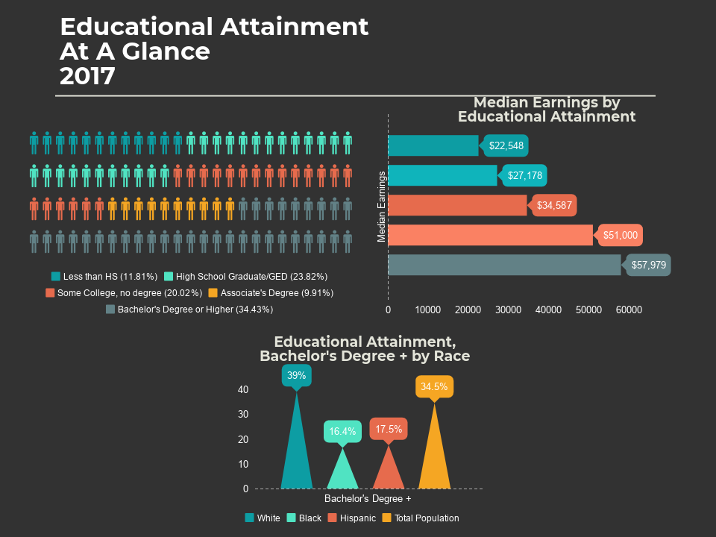
Notes:
Educational attainment is a powerful predictor of a community’s well-being. A higher educational attainment is strongly correlated with higher wages and lower unemployment rates. Since educational attainment is measured for adults age 25 and over, increases in attainment are typically not significant when looking from year to year. Trend data is presented to show what changes in educational attainment are present in the community.

Slide 36
Notes:
A higher percentage of Greenville County residents have less than high school education than the peer counties at 3.9%, and a smaller portion of the population has a bachelor’s degree or higher than the peer counties at 34.4%.
Source: United States Census Bureau, 2017

Slide 37
Notes:
The county has had a decline in the percentage of residents with a graduate degree from 2013 to 2017, while other educational attainment levels have had little change.
Source: United States Census Bureau, 2013-2017

Slide 38
Notes:
Source: United States Census Bureau, 2013-2017

Slide 39
Notes:
A higher percentage of females in the county hold a graduate degree than their male counterparts, but a higher percentage of males hold a bachelor’s degree.
Disparities exist by race and whites are more likely to have graduated high school and to have a bachelor’s degree than their black and Hispanic counterparts.
Source: United States Census Bureau, 2017

Slide 40
Median Earnings In the Past 12 Months (2013 and 2017 Inflation-Adjusted Dollars) by Educational Attainment Population 25+ 2013 & 2017
 | Median 12-Month Earnings 2013 |  | Median 12-Month Earnings 2017
 | Greenville County | United States | Greenville County | United States
Less than a high school graduate | $ 18,113 | $ 20,149 | $ 22,548 | $ 23,031
High school graduate or equivalent | $ 26,349 | $ 27,350 | $ 27,178 | $ 30,624
Some college or associate's degree | $ 31,277 | $ 32,387 | $ 34,587 | $ 36,190
Bachelor's degree | $ 48,082 | $ 50,050 | $ 51,000 | $ 52,484
Graduate or professional degree | $ 53,530 | $ 65,565 | $ 57,979 | $ 71,097
Notes:
Source: United States Census Bureau, 2013-2017

Slide 41
Retention and Graduation Rates for Colleges/Universities in Greenville County 2018
 | Retention Rate | Graduation Rate (3-year or 6-year)
Bob Jones University | 82.0% | 72.0%
Furman University | 93.0% | 84.0%
Greenville Technical College | 54.0% | 8.0%
North Greenville University | 70.0% | 50.0%
Notes:
3-year rates are for technical/2-year colleges
6-year rates are for bachelors granting/4-year colleges
Source: IPEDS Data Center, 2018

Slide 42
Occupational Outlook

Slide 43
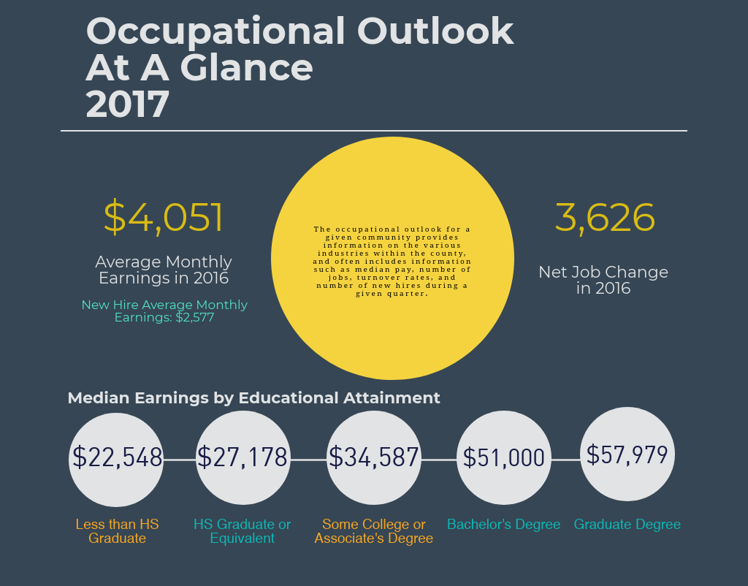

Slide 44
Yearly Average Workforce Indicators for All Sectors Greenville County
 | 2012 | 2013 | 2014 | 2015 | 2016
Total Employment | 216,128 | 220,458 | 223,885 | 231,156 | 234,802
Net Job Change | 1,919 | 2,484 | 3,098 | 3,108 | 3,626
Hiring Rate | 12.4% | 12.9% | 13.9% | 14.2% | 14.7%
Separation Rate | 11.6% | 12.0% | 12.7% | 13.0% | 13.3%
Turnover | 9.0% | 9.3% | 9.8% | 10.1% | 10.3%
Avg Monthly Earnings | $ 3,814 | $ 3,887 | $ 3,955 | $ 4,088 | $ 4,051
Avg New Higher Earnings | $ 2,404 | $ 2,412 | $ 2,370 | $ 2,492 | $ 2,577
Notes:
Job turnover is stable and wages (total wages and new hire wages) have increased each year. Job creations have also increased over the past 5 years.
Source: United States Census Bureau, Center for Economic Studies, 2012-2016
*2017 data is not complete, and thus not comparable to previous years.

Slide 45
New Hires by Industry Greenville County, 2017 Quarter 3
 | New Hire Counts | End of Quarter Hiring Rate | Average Monthly Earnings | New Hire Average Monthly Earnings
Accommodation and Food Services | 9,372 | 24.2% | $ 1,656 | $ 1,185
Administrative and Support and Waste Management and Remediation Services | 21,742 | 34.2% | $ 2,780 | $ 2,191
Agriculture, Forestry, Fishing and Hunting | 54 | 22.4% | $ 2,484 | $ 2,090
Arts, Entertainment, and Recreation | 728 | 13.2% | $ 2,006 | $ 1,171
Construction | 2,245 | 13.6% | $ 5,013 | $ 3,899
Educational Services | 1,841 | 12.0% | $ 3,497 | $ 1,967
Finance and Insurance | 922 | 8.7% | $ 5,775 | $ 4,350
Health Care and Social Assistance | 4,556 | 9.3% | $ 4,669 | $ 2,815
Information | 581 | 7.5% | $ 5,067 | $ 3,722
Management of Companies and Enterprises | 830 | 12.6% | $ 5,617 | $ 3,152
Manufacturing | 3,193 | 7.8% | $ 5,363 | $ 3,795
Mining, Quarrying, and Oil and Gas Extraction | 4 | 4.3% | $ 4,981 | $ 4,550
Other Services (except Public Administration) | 1,268 | 14.8% | $ 3,096 | $ 1,976
Professional, Scientific, and Technical Services | 2,193 | 10.6% | $ 5,952 | $ 4,289
Public Administration | 362 | 6.0% | $ 3,415 | $ 2,283
Real Estate and Rental and Leasing | 851 | 12.3% | $ 4,249 | $ 3,136
Retail Trade | 6,193 | 15.3% | $ 2,635 | $ 1,619
Transportation and Warehousing | 1,696 | 15.3% | $ 3,964 | $ 2,703
Wholesale Trade | 1,449 | 7.7% | $ 5,666 | $ 3,790
All NAICS Sectors | 60,095 | 15.3% | $ 4,109 | $ 2,487
Notes:
New hires by industry are the closes statistic we have that reflects job growth in Greenville County. All the industries except for the following have higher end of quarter hiring rates than the State rate:
Arts, Entertainment, and Recreation (State: 13.9%)
Construction (State: 15.0%)
Health Care and Social Assistance (State: 10.3%)
Information (State: 9.0%)
Mining, Quarrying, and Oil and Gas Extraction (State: 7.9%)
Professional, Scientific, and Technical Services (State: 12.0%)
Public Administration (State: 7.1%)
Real Estate and Rental and Leasing (State: 12.8%)
Retail Trade (State: 16.0%)
Transportation and Warehousing (State: 16.4%)
Wholesale Trade (State: 9.0%)
Source: United States Census Bureau, Quarterly Workforce Indicators LED Extraction Tool

Slide 46
Notes:
Wages increase by educational level whether measured at the national, state, or local level.
Source: United States Census Bureau, 2013-2017

Slide 47
Notes:
Median earnings by educational attainment level exceed earnings in the peer counties, SC, & US except for bachelor’s degree median earnings and graduate degree median earnings.
Source: United States Census Bureau, 2017

Slide 48
Notes:
Poverty rates decrease with educational attainment level. In Greenville County in 2017, poverty rates by educational attainment were lower than Richland County and the State.
In 2017, the federal poverty level (FPL) for a family of four was $25,100 or $2,091/month. In looking back at slide 36, six of the industries listed have an average new higher monthly earnings that are below FPL and one industry has an average monthly earnings below FPL (Accommodations and Food Services).
Source: United States Census Bureau, 2017

Slide 49
Economic Development

Slide 50
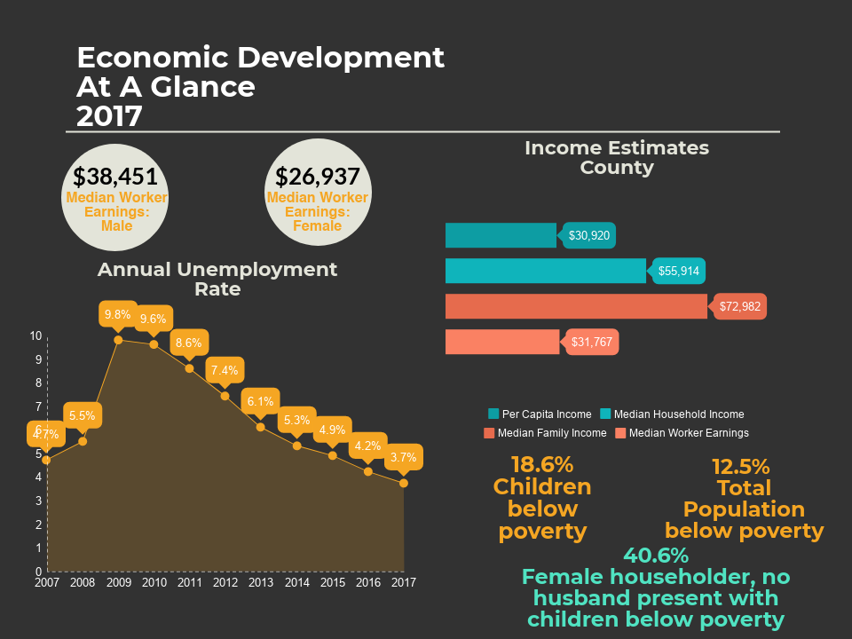
Notes:
Economic indicators drive the market and, in many ways, determine future investment in the community. Economic development is imperative to bringing living wage jobs and a higher standard of living to the community.

Slide 51
Income Estimates 2013 and 2017
 | Greenville County |  | South Carolina |  | United States
 | 2013 | 2017 | 2013 | 2017 | 2013 | 2017
Per Capita Income (in 2012 and 2016 Inflation Adjusted Dollars) | $25,436 | $30,920 | $23,687 | $ 27,909 | $ 28,184 | $ 32,397
Median Household Income | $ 49,330 | $ 55,914 | $ 44,163 | $ 50,570 | $ 52,250 | $ 60,336
Median Family Income | $ 62,355 | $ 72,982 | $ 54,686 | $ 62,432 | $ 64,030 | $ 73,891
Median Worker Earnings (16+) | $ 28,885 | $ 31,767 | $ 26,559 | $ 30,021 | $ 30,454 | $ 33,646
Notes:
Various indicators measure income and the table below provide income estimates for Greenville County with comparison to the state and national averages.
Source: United States Census Bureau, 2013 & 2017

Slide 52
Median Income Distribution by Census Tract
Notes:
Red shaded areas indicate those census tracts with the LOWEST median income. Dark Green indicate census tracts with highest median income.
Source: United States Census Bureau, 2017

Slide 53
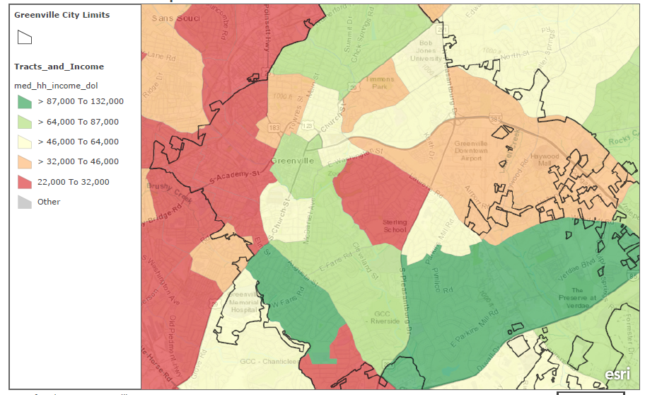
Median Income Distribution by Census Tract: City of Greenville
Notes:
Red shaded areas indicate those census tracts with the LOWEST median income. Dark Green indicate census tracts with highest median income.
Source: United States Census Bureau, 2017

Slide 54
Notes:
Male median earnings are approximately $12,000 more than female median earnings in 2017.
Source: United States Census Bureau, 2017

Slide 55
Poverty by Upstate County, State, and United States 2013 and 2017
 | Total People in Poverty |  | Percent of People in Poverty |  | Children, 18 and Under in Poverty |  | Percent Children, 18 and Under in Poverty
 | 2013 | 2017 | 2013 | 2017 | 2013 | 2017 | 2013 | 2017
Abbeville* | 5,272 | 5,474 | 21.6% | 22.7% | 1,758 | 1,678 | 31.5% | 32.1%
Anderson | 30,570 | 28,142 | 16.2% | 14.4% | 10,140 | 9,452 | 22.8% | 21.2%
Cherokee* | 12,550 | 12,292 | 23.0% | 22.0% | 4,578 | 4,179 | 34.3% | 31.7%
Greenville | 76,809 | 61,652 | 16.6% | 12.5% | 29,762 | 21,497 | 26.8% | 18.6%
Greenwood* | 15,499 | 16,297 | 23.1% | 24.2% | 5,628 | 6,192 | 35.5% | 39.9%
Laurens* | 13,249 | 13,280 | 20.6% | 20.7% | 5,130 | 4,601 | 34.3% | 31.7%
Oconee* | 14,067 | 13,993 | 19.1% | 18.6% | 4,132 | 4,096 | 27.3% | 27.2%
Pickens* | 21,033 | 20,987 | 18.9% | 18.3% | 4,616 | 3,972 | 19.6% | 17.2%
Spartanburg | 53,956 | 40,590 | 19.1% | 13.6% | 19,296 | 13,779 | 28.5% | 19.8%
Union* | 5,657 | 5,258 | 20.1% | 19.3% | 1,919 | 1,701 | 30.6% | 29.8%
South Carolina | 860,380 | 751,907 | 18.6% | 15.4% | 291,832 | 245,023 | 27.5% | 22.6%
United States | 48,810,868 | 42,583,651 | 15.8% | 13.4% | 16,086,960 | 13,353,202 | 22.2% | 18.4%
*Smaller counties use 5-year estimates
Notes:
Poverty is correlated with negative outcomes such as low educational status, increased crime rates, poorer health, and an increase of teen childbearing, among others. South Carolina continues to have a higher poverty rate than the national average.
Greenville County has some of the lowest poverty rates among all 10 of the Upstate counties in 2017.
Source: United States Census Bureau, 2013 & 2017

Slide 56
Notes:
Females and those who are not white have higher poverty rates than the counterparts in 2017, with Hispanics having the highest poverty rates at 24.4% (or nearly 1 in 4).
Source: United States Census Bureau, 2017

Slide 57
Percent of Families whose Income in the Past 12 Months is Below Poverty Level Peer Counties, SC & US 2013 and 2017
 | All Families |  | Married Couple Families |  | Female Householder (no husband present)
 | 2013 | 2017 | 2013 | 2017 | 2013 | 2017
Greenville County | 12.9% | 8.8% | 5.7% | 4.1% | 39.0% | 27.7%
(with Children) | 21.2% | 15.0% | 8.3% | 6.0% | 53.6% | 40.6%
Charleston County | 12.8% | 6.8% | 5.1% | 2.4% | 38.9% | 20.8%
Richland County | 13.8% | 12.3% | 4.4% | 4.3% | 36.5% | 32.9%
South Carolina | 14.4% | 11.3% | 6.4% | 4.8% | 36.0% | 30.7%
United States | 11.6% | 9.5% | 5.8% | 4.8% | 30.9% | 26.2%
Notes:
Over 1 in every 4 female householder, no husband present household lives below poverty, and a significant percentage (40.6%) with children live below poverty.
Source: United States Census Bureau, 2013 & 2017

Slide 58
Distribution of Total Population in Poverty
Notes:
The darker the shade of red, the higher the percentage of the population in poverty in that census tract.
Source: United States Census Bureau, 2017

Slide 59
Distribution of Total Population in Poverty
City of Greenville Area
Notes:
The darker the shade of red, the higher the percentage of the population in poverty in that census tract.
Source: United States Census Bureau, 2017

Slide 60
Distribution of Children under 18 in Poverty
Notes:
The darker the shade of red, the higher the percentage of the population in poverty in that census tract.
Source: United States Census Bureau, 2017

Slide 61
Distribution of Children in Poverty
City of Greenville Area
Notes:
The darker the shade of red, the higher the percentage of the population in poverty in that census tract.
Source: United States Census Bureau, 2017

Slide 62
Percentages on graph represent Greenville County unemployment rates
Notes:
When individuals are unemployed, the community loses. Families lose wages, the economy loses the purchasing power of those individuals, and the workforce loses production of goods or services. The unemployment rate is represented as a percentage by taking the number of individuals who are jobless and available to work (unemployed) and dividing that by the number of people in the labor force (those actively employed and unemployed).
Greenville County has consistently had lower unemployment rates than the State and United States for the past 11 years.
Source: South Carolina Works Online Services, Community Profiles

Slide 63
Greenville County Employment and Wages by Industry, Annual Average 2013 & 2017
 |  | Number of Companies |  | Average Weekly Wage |  | Average Annual Pay
 |  | 2013 | 2017 | 2013 | 2017 | 2013 | 2017
Private, Goods-Producing |  | 1,779 | 1,930 | $ 1,059 | $ 1,224 | $ 55,048 | $ 63,643
 | Natural Resources and Mining | 19 | 36 | $ 510 | $ 663 | $ 26,495 | $ 34,491
 | Construction | 1,072 | 1,190 | $ 898 | $ 1,246 | $ 46,689 | $ 64,796
 | Manufacturing | 688 | 704 | $ 1,111 | $ 1,218 | $ 57,795 | $ 63,353
Private, Service-Providing |  | 10,135 | 11,602 | $ 770 | $ 842 | $ 40,024 | $ 43,799
Trade, Transportation, & Utilities |  | 2,931 | 2,984 | $ 744 | $ 809 | $ 38,714 | $ 42,083
 | Wholesale Trade | 921 | 928 | $ 1,145 | $ 1,258 | $ 59,544 | $ 65,413
 | Retail Trade | 1,698 | 1,721 | $ 514 | $ 569 | $ 26,711 | $ 29,573
 | Transportation & Warehouse | 296 | 311 | $ 885 | $ 903 | $ 46,000 | $ 46,936
 | Utilities | 17 | 25 | $ 1,385 | $ 1,470 | $ 72,015 | $ 76,436
Information |  | 215 | 255 | $ 1,027 | $ 1,201 | $ 53,409 | $ 62,466
Financial Activities |  | 1,358 | 1,550 | $ 1,100 | $ 1,210 | $ 57,219 | $ 62,906
Professional & Business Services |  | 2,495 | 2,899 | $ 864 | $ 922 | $ 44,930 | $ 47,955
Education & Health Services |  | 1,112 | 1,343 | $ 928 | $ 1,001 | $ 48,274 | $ 52,071
Leisure & Hospitality |  | 1,252 | 1,350 | $ 292 | $ 340 | $ 15,182 | $ 17,684
Other Services |  | 1,180 | 1,221 | $ 543 | $ 635 | $ 28,261 | $ 32,994
Total Federal Government |  | 54 | 52 | $ 1,265 | $ 1,302 | $ 65,783 | $ 67,724
Total State Government |  | 23 | 32 | $ 692 | $ 745 | $ 35,756 | $ 38,738
Total Local Government |  | 196 | 222 | $ 818 | $ 894 | $ 42,515 | $ 46,466
 | Education & Health Services | 140 | 163 | $ 833 | $ 892 | $ 43,330 | $ 46,401
Total All Industries |  | 12,595 | 13,837 | $ 823 | $ 911 | $ 42,804 | $47,348
Notes:
Quarterly workforce indicators reflect the churning in the labor market as workers enter and exit jobs and businesses expand and contract.
Source: United States Census Bureau, Center for Economic Studies

Slide 64
Notes:
Commuting patterns, or the flow of workers from place of residence to place of work, is an indicator of several economic conditions for a given area. Primarily, these patterns can reflect the availability and quality of work locally and in surrounding counties.
Source: United States Census Bureau, 2017

Slide 65
Tax Returns Filed with Earned Income Credit Greenville County 2012
 | Number of returns | Amount
County Total | 35,400 | $ 86,034
By Adjusted Gross Income
Under $1 | 170 | $ 190
$1 under $10,000 | 8,390 | $ 9,853
$10,000 under $25,000 | 16,210 | $ 53,773
$25,000 under $50,000 | 10,490 | $ 22,169
$50,000 under $75,000 | 140 | $ 49
$75,000 under $100,000 | - | $ -
$100,000 under $200,000 | - | $ -
$200,000 or more | - | $ -
Tax Returns Filed with Earned Income Tax Credit Greenville County 2016
 | Number of returns | Amount
County Total | 41,410 | $ 100,153
By Adjusted Gross Income
Under $1 | 240 | $ 296
$1 under $10,000 | 9,530 | $ 11,314
$10,000 under $25,000 | 18,480 | $ 61,147
$25,000 under $50,000 | 12,930 | $ 27,316
$50,000 under $75,000 | 230 | $ 80
$75,000 under $100,000 | - | $ -
$100,000 under $200,000 | - | $ -
$200,000 or more | - | $ -
Notes:
IRS explanation for earned income tax credit: "Earned income credit" includes both the refundable
and non-refundable portions. The non-refundable portion could reduce income tax and certain related taxes to zero. The earned income credit amounts in excess of total tax liability, or amounts when there was no tax liability at all, were refundable.
In 2016, 35,400 of the number of returns with the Earned Income Tax Credit received was considered Excess Earned Income Credit (refundable). The amount refunded equaled $86,034, with almost $54,000 of that going to returns with an AGI of $25,000 under $50,000.
Source: IRS State Tax Files, 2012 & 2016

Slide 66
Greenville MSA: Greenville-Anderson-Mauldin
Greenville MSA boundaries changed between 2015 and 2017 survey. Unable to report historical data.
Notes:
6.7% of households in the State are unbanked compared to 4.9% in the Greenville MSA.
Source: FDIC National Survey of Unbanked and Underbanked Households, 2017
Historical surveys from 2009, 2011, 2013, and 2015 available. Because Greenville MSA boundaries have changed, historical data was not included in this report. To see historical data, please visit: https://www.economicinclusion.gov/

Slide 67
Family and Youth & Crime and Safety

Slide 68
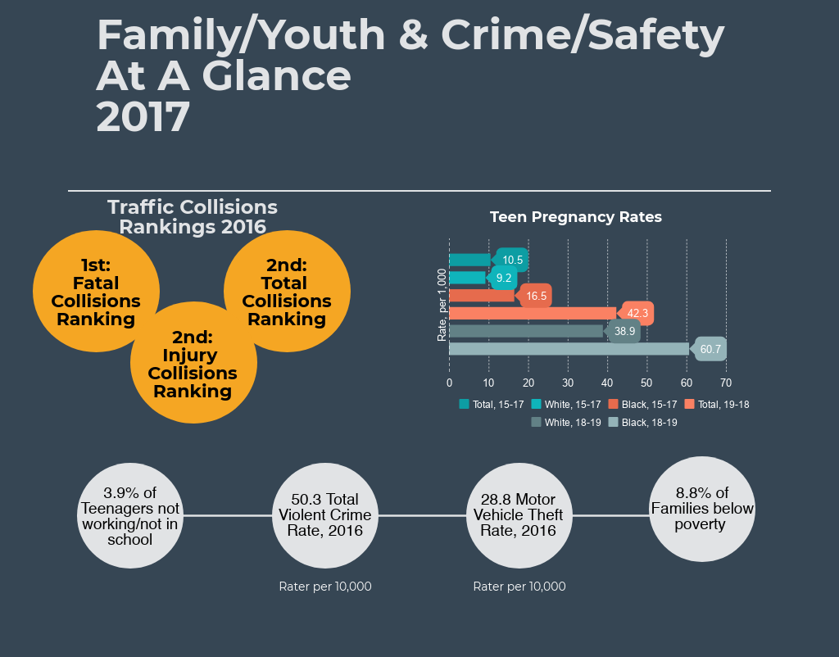
Notes:
Family and youth indicators allow for assessing risk in a community, family, and school environments. These metrics can increase awareness of factors that predict unwanted outcomes for the largest sectors of the community.
To implement proactive strategies to keep the community safe, it is imperative that accurate, timely, and complete crime data be available.

Slide 69
Greenville County Poverty Data 2017
 |  | Number Below Poverty | Percent Below Poverty | South Carolina | United States
All Residents |  | 61,652 | 12.5% | 15.4% | 13.4%
 | Children under age 18 | 21,497 | 18.6% | 22.6% | 18.4%
Families |  |  | 8.8% | 11.3% | 9.5%
 | Married Couples |  | 4.1% | 4.8% | 4.8%
 | Female Householder, no husband present |  | 27.7% | 30.7% | 26.2%
Households below FPL that receive food stamps |  |  | 56.5% | 52.0% | 47.2%
Family Household and Income Statistics 2017
 | Greenville County | South Carolina | United States
Average Household Size | 2.56 | 2.57 | 2.65
Average Family Size | 3.18 | 3.17 | 3.26
Per Capita Income (in 2016 Inflation Adjusted Dollars) | $ 30,920 | $ 27,909 | $ 32,397
Median Household Income | $ 55,914 | $ 50,570 | $ 60,336
Median Family Income | $ 72,982 | $ 62,432 | $ 73,891
Notes:
Income is generally used as a measure of the economic well-being of a community and a measure of how well residents of the community are living. Income is measured variously to capture subtle but important differences.
Source: United States Census Bureau, 2017

Slide 70
Rates per 1,000 population
Notes:
Teen pregnancy has substantial implications for educational and socioeconomic outcomes for the teen mother. Parenthood is the leading reason that teen girls drop out of school. More than 50% of teen mothers never graduate from high school; approximately 90% of women who do not give birth during their teenage years will graduate from high school. Additionally, less than 2% of teen moms earn a college degree by age 30.
Teen pregnancy rates have fallen over the past 5 years, but disparities exist by race with black teenagers have higher pregnancy rates than their white counterparts.
Source: South Carolina Department of Health and Environmental Control
Center for Disease Control and Prevention, About Teen Pregnancy
DoSomething.org, 11 Facts about Teen Pregnancy

Slide 71
Notes:
Greenville County has had little disparities in the percentage of teenage idleness from 2012 to 2016.
Source: United States Census Bureau, 2012-2016

Slide 72
Violent Crimes by County 2012 and 2016
 |  | Violent Crime Total |  | Sexual Battery |  | Murder |  | Robbery |  | Aggravated Assault
 |  | # | Rate | # | Rate | # | Rate | # | Rate | # | Rate
Greenville County | 2012 | 2,907 | 62.2 | 320 | 6.8 | 22 | 0.47 | 455 | 9.7 | 2110 | 45.1
 | 2016 | 2,508 | 50.3 | 296 | 5.9 | 29 | 0.6 | 435 | 8.7 | 1748 | 35
Charleston County | 2016 | 1,958 | 49.4 | 175 | 4.4 | 50 | 1.3 | 479 | 12.1 | 1254 | 31.6
Richland County | 2016 | 3,163 | 77.2 | 246 | 6 | 36 | 0.9 | 613 | 15 | 2268 | 55.4
South Carolina | 2016 |  | 50.8 |  | 5.2 |  | 0.7 |  | 8.2 |  | 36.7
Rate per 10,000 population
Notes:
Crime data are collected consistently throughout South Carolina in accordance with the National Incident Based Reporting System (NIBRS). There are eight offense categories: murder, sexual battery (rape), robbery, aggravated assault, breaking and entering, larceny, motor vehicle theft, and arson. These are typically categorized as violent crimes (murder, sexual battery, robbery, and aggravated assault) and property crimes (breaking and entering, larceny, and motor vehicle theft) to provide basic measure of crime. Arson is not considered a property crime through state reporting documents.
Since only those crimes that are reported are counted, there is no way of determining the actual number of crimes committed.
Greenville County has a higher robbery and sexual battery rates in 2016 than the state rate.
Source: South Carolina Law Enforcement Division, Crimes in South Carolina Book

Slide 73
Property Crime by County 2012 and 2016
 |  | Property Crime Total |  | Breaking and Entering |  | Larceny |  | Motor Vehicle Theft
 |  | # | Rate | # | Rate | # | Rate | # | Rate
Greenville County | 2012 | 16,749 | 358.2 | 4,057 | 86.8 | 11,401 | 243.8 | 1,291 | 27.6
 | 2016 | 15,325 | 307.3 | 2,990 | 59.9 | 10,827 | 217.1 | 1,434 | 28.8
Charleston County | 2016 | 13,575 | 342.4 | 2,031 | 51.2 | 10,297 | 259.7 | 1,212 | 30.6
Richland County | 2016 | 18,492 | 451.5 | 3,055 | 74.6 | 13,097 | 319.8 | 2,281 | 55.7
South Carolina | 2016 |  | 333.2 |  | 67.3 |  | 235.2 |  | 29.3
Rate per 10,000 population
Notes:
Overall, Greenville County has lower property crime rates than the peer counites and the state in 2016.
Source: South Carolina Law Enforcement Division, Crimes in South Carolina Book

Slide 74
Rankings out of 46 counties with 1 being highest collision rates and 46 being lowest collision rates
Greenville County Motor Vehicle Traffic Collision Trends 2015-2016
 | 2015 | 2016
Total collisions ranking by county | 1 | 2
Fatal collisions ranking by county | 2 | 1
Injury collisions ranking by county | 2 | 2
Number of SC drivers licenses | 376,928 | 382,859
Number of SC vehicle registrations | 425,200 | 434,864
Motor vehicle death rate per 100,000 | 14.9 | 17.4
Economic loss (rounded to $100,000) | $ 405,664,800 | $ 443,806,200
Number of fatalities involving an alcohol impaired drive (BAC >.08) | 25 | 23
Number of non-fatal collisions involved DUI | 614 | 659
Notes:
The South Carolina Department of Public Safety analyzes all motor vehicle collision reports and produces an annual Traffic Collision Fact Book with statewide and local data. Traffic collisions are responsible for billions of dollars in economic loss in the state each year.
Greenville County has had one of the highest collisions ranking (total, fatal, and injury) out of the 46 counties for the past 2 years.
Source: South Carolina Department of Public Safety, Highway Safety, & Justice Programs

Slide 75
Public Health

Slide 76
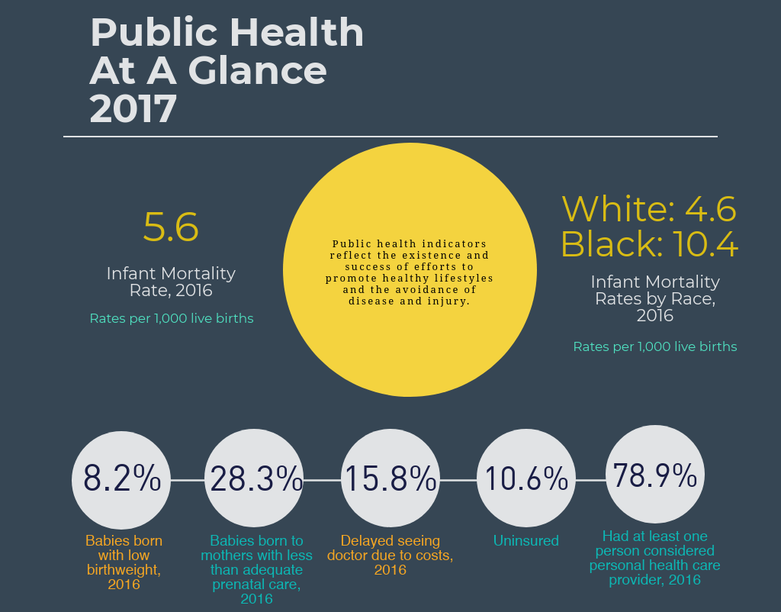
Notes:
Public health indicators reflect the existence and success of efforts to promote healthy lifestyles and the avoidance of disease and injury. Where there are robust public health efforts, there is improved quality of life and life expectancy.

Slide 77
Notes:
Infant mortality rates are important indicators of health for the whole population, reflecting the factors affecting the health of the whole population have an impact on the mortality rate of infants in each community. Infant mortality is the measure of death within the first year of life and is reported as a rate per 1,000 live births. Because there is a historic racial disparity in infant mortality, it is instructive to examine the data for both blacks and whites and the Hispanic population in the county.
Greenville County has had little change in infant mortality rates from 2012 to 2016.
Source: South Carolina Department of Health and Environmental Control

Slide 78
Notes:
There are significant disparities by race in the county for infant mortality, with black infants having higher mortality rates than white infants.
It is important to note that caution should be used when looking at single year rates for Hispanic infants as there is a large margin of error.
Source: South Carolina Department of Health and Environmental Control

Slide 79
Notes:
Low birth weight is a primary predictor of infant mortality, and children who had a low birth weight have higher incidences of ongoing physical disabilities, behavior problems, poor cognitive performance, and learning disabilities.
Access to prenatal care is a primary determinant of birth weight and, therefore, infant mortality.
There are significant disparities in the County regarding babies born with a low birthweight with a higher percentage of black babies born with a low birthweight than their white counterparts.
More than 1 out of every 4 babies is born to a mother with less than adequate prenatal care in 2016 in the County.
Source: South Carolina Department of Health and Environmental Control

Slide 80
Risk Factors for Chronic Conditions Greenville County & SC 2014-2016
 | Greenville County | South Carolina
Hypertension | 37.2% | 38.7%
Coronary heart disease | 5.4% | 4.6%
Diabetes | 11.4% | 12.3%
Current Smoking | 17.0% | 20.4%
Adults categorized as obese | 28.8% | 32.7%
Delayed seeing a doctor in the last year due to cost | 15.8% | 16.7%
Has at least one person considered a personal doctor or health care provider | 78.9% | 77.8%
Notes:
Common behavioral risk factors contribute significantly to chronic disease and death in South Carolina. The Behavior Risk Factor Surveillance Survey (BRFSS) tracks the prevalence of these risk factors by county. The latest data available are for 2016.
Source: South Carolina Department of Health and Environmental Control

Slide 81
Percent Uninsured Peer Counties & SC 2017
 | Greenville County | Charleston County | Richland County | South Carolina
Age
Under 19 | 5.3% | 8.5% | 3.5% | 5.1%
19-64 | 15.1% | 16.5% | 13.8% | 16.4%
65 years and older | 0.8% | 0.5% | 0.3% | 0.4%
Educational Attainment (population 25 years +)
Less Than High School | 26.3% | 31.4% | 30.2% | 24.4%
High School Graduate or Equivalent | 15.3% | 23.3% | 17.4% | 16.0%
Some College or Associate's Degree | 9.3% | 13.8% | 10.0% | 10.3%
Bachelor's Degree or Higher | 4.2% | 3.7% | 4.2% | 4.5%
Work Status (population 19-64 years)
Worked Full-Time, year round in the past 12 months | 11.7% | 14.0% | 9.7% | 11.6%
Worked Less Than Full Time, year round in the past 12 months | 21.2% | 23.0% | 17.3% | 23.2%
Did Not Work | 18.0% | 17.0% | 22.0% | 20.6%
Notes:
The health insurance coverage rate is, in part, a reflection of the quality of jobs in a specific area, and the changes in the rate of coverage and the distribution of the coverage could reflect the economic trends. In 2014, the implementation of the Affordable Care Act (ACA) produced significant changes in the insurance coverage rates.
The portion of the population that is usually measured for health insurance coverage is working age adults, 18 to 64, as this segment is exempt from public insurance by entitlement of age or income. People age 65 and older are covered by public insurance (most often Medicare) and low-income children are covered by public insurance in the form of Medicaid. Persons who do not have any source of health insurance and go without primary care often end up being treated as emergency patients; a much costlier mode of treatment than prevention or accessing primary care via insurance coverage.
Source: United States Census Bureau, 2013-2017

Slide 82
Notes:
In Greenville County, those who are Hispanic and those who fall within a lower income bracket are more likely to be uninsured.
Source: United States Census Bureau, 2017

Slide 83
ED Visits by Type: White Greenville County 2017
 | Visits | Average Charge
Commercial/HMO | 31,436 | $ 3,641
Medicaid | 22,173 | $ 2,328
Medicare | 31,366 | $ 4,618
Self/Indigent | 29,596 | $ 3,050
ED Visits by Type: Total Greenville County 2017
 | Visits | Total Charges | Average Charge
Commercial/HMO | 48,827 | $ 199,165,958 | $ 3,407
Medicaid | 49,034 | $ 126,556,118 | $ 2,173
Medicare | 46,266 | $ 231,499,501 | $ 4,270
Self/Indigent | 56,790 | $ 193,417,336 | $ 2,901
ED Visits by Type: Non-White Greenville County 2017
 | Visits | Average Charge
Commercial/HMO | 17,382 | $ 2,973
Medicaid | 26,859 | $ 2,052
Medicare | 14,898 | $ 3,546
Self/Indigent | 27,190 | $ 2,728
Notes:
A higher percentage of payor sources for emergency department visits in 2017 for those who are non-white was Medicaid and self/indigent than for those who are white in Greenville County.
Revenue and Fiscal Affairs disaggregates race by white and non-white only.
Source: South Carolina Revenue and Fiscal Affairs

Slide 84
ED Visits for Behavioral Health: White Greenville County 2017
 | # of Visits | Average Charge
Commercial/HMO | 1,187 | $ 2,946
Medicaid | 932 | $ 2,829
Medicare | 1,211 | $ 3,758
Self/Indigent | 2,181 | $ 2,960
ED Visits for Behavioral Health: Total Greenville County 2017
 | # of Visits | Total Charges | Average Charge
Commercial/HMO | 1,540 | $ 4,924,280 | $ 2,894
Medicaid | 1,547 | $ 4,734,827 | $ 2,767
Medicare | 1,709 | $ 6,917,223 | $ 3,595
Self/Indigent | 3,087 | $ 10,218,228 | $ 2,948
ED Visits for Behavioral Health: Non-White Greenville County 2017
 | # of Visits | Average Charge
Commercial/HMO | 353 | $ 2,670
Medicaid | 615 | $ 2,692
Medicare | 498 | $ 3,241
Self/Indigent | 905 | $ 2,908
Notes:
38.2% of non-white emergency department visits for behavioral health was self/indigent payor source.
39.6% of white ED visits were self/indigent
25.9% of non-white emergency department visits for behavioral health was Medicaid payor source.
16.9% of white ED visits were Medicaid
Revenue and Fiscal Affairs disaggregates race by white and non-white only.
Source: South Carolina Revenue and Fiscal Affairs

Slide 85
Notes:
Source: South Carolina Department of Health and Environmental Control

Slide 86
Notes:
Source: South Carolina Department of Health and Environmental Control

Slide 87
Affordable Housing

Slide 88
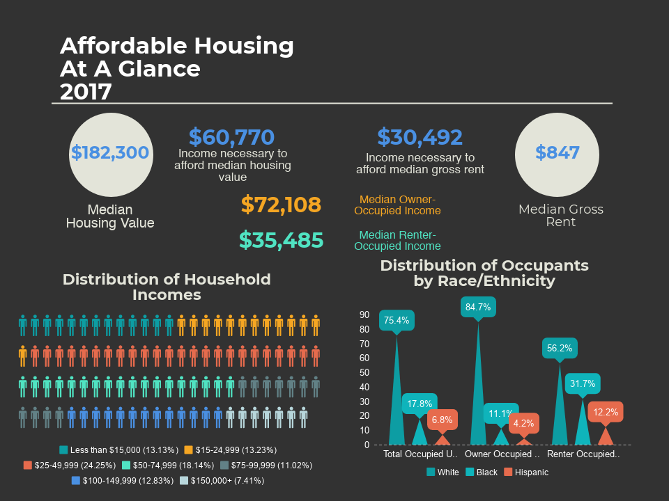
Notes:
Definition of Affordable Housing
According to the United States Department of Housing and Urban Development (HUD), the generally accepted definition of affordable housing is “[housing] for which the occupant(s) is/are paying no more than 30 percent of his or her income for gross housing costs, including utilities. Please note that some jurisdictions may define affordable housing based on other, locally determined criteria, and that this definition is intended solely as an approximate guideline or general rule of thumb.”
In this section, the 30% rule will only be applied to the housing expenses of sales price and gross rent. Other housing expenses often included in the 30% threshold (utilities, etc.) will not be accounted for.
Source: United States Housing and Urban Development

Slide 89
Notes:
Source: United States Census Bureau, 2013 & 2017

Slide 90
Notes:
When considering who owns and rents housing in Greenville County, whites are more likely to be homeowners while those who are black or Hispanic are more likely to be renters.
Source: United States Census Bureau, 2017

Slide 91
Greenville County total number of housing units increased by 12,916 between 2013 and 2017
Notes:
Greenville County’s housing stock increase from 2013 to 2017 is a similar percentage as the overall population growth during the same timespan. It is important to note that while the percentage of housing units increased by the same percentage, the number of housing units could either be too few or too many housing units available.
Source: United States Census Bureau, 2013-2017

Slide 92
*Manufactured Housing includes mobile homes, boats, RVs, and vans
Notes:
Understanding the data related to housing units in the county can provide insight into the population’s ability to become (or stay) homeowners relative to affordability.
Source: United States Census Bureau, 2017

Slide 93
Homeowner and Rental Vacancy Rates Peer Counties, SC & US 2017
 | Homeowner Vacancy Rate | Rental Vacancy Rate
Greenville County | 0.6% | 6.7%
Charleston County | 2.9% | 9.1%
Richland County | 2.1% | 7.0%
South Carolina | 1.8% | 9.0%
United States | 1.6% | 6.2%
Notes:
Low vacancy rates can drive up gross rent and household values.
Greenville County has some of the lowest homeowner and rental vacancy rates in comparison to the peer counties, SC, & US in 2017. The county is seeing a slight upward trend in rental vacancy rates and a slight downward trend in homeowner rates which could indicate that individuals are moving from renting to homeownership.
Source: United States Census Bureau, 2013-2017

Slide 94
Vacant Units by Type Greenville County 2017
 | Count | Percentage of Total Vacancies
Total Units Vacant | 17,714
For Rent | 4,614 | 26.0%
Rented, not occupied | 1,130 | 6.4%
For sale only | 800 | 4.5%
Sold, not occupied | 1,682 | 9.5%
Seasonal, recreational or occasional use | 1,367 | 7.7%
For migrant workers | 0 | 0.0%
Other vacant | 8,121 | 45.8%
Notes:
There has been a downward trend in the overall vacancy rate between 2013 and 2017, and the occupancy rates reflect the changes observed in the vacancy rates on the previous slide.
One out of every four vacant units is available for rent and just under ½ of the total vacant units is classified as some other vacant; meaning it is not for rent, for sale, seasonal, or for migrant workers.
Source: United States Census Bureau, 2013-2017

Slide 95
Notes:
Homeowners have consistently had a higher median income than renters in the County with the homeowner median rent of $72,108 compared to renters median rent of $35,485 in 2017.
The 2017 income amounts on this chart will be used to determine housing affordability on a later slide.
Source: United States Census Bureau, 2013-2017

Slide 96
Notes:
When considering housing affordability and the population’s ability to save for homeownership, it is important to look at gross rent trends in the county. High rent prices compared to a low median household income could indicate many of those who are renters will not have enough purchasing power to become homeowners, as they are likely to be spending more than 30% of their income on housing expenses.
The 2017 median gross rent will be used to calculate housing affordability on a later slide.
Source: United States Census Bureau, 2013-2017

Slide 97
Housing Market Snapshots Greenville MSA 2013-2017
 | 2013 | 2014 | 2015 | 2016 | 2017
Median Sales Price | $159,200 | $165,400 | $175,100 | $186,200 | $195,700
Income Necessary to Afford to Purchase Median Sales Priced Home Greenville County 2017
 | Median Household Income | Owner-Occupied | Renter-Occupied
3x the 2017 Median Household Income | $ 167,742 | $ 216,324 | $ 106,455
2017 Median Income | $ 55,914 | $ 72,108 | $ 35,485
Median Housing Value | $ 182,300 | $ 182,300 | $ 182,300
Difference of 3x Median Income and Median Value | ($14,558) | $34,024 | ($75,845)
Because the median sales price is for the Greenville MSA, the median housing value is used to calculate affordability.
The median housing value for 2017 was $182,300.
Notes:
Homeowner affordability is calculated using the median housing value compared to the median owner income and renter affordability is calculated using the median gross rent compared to the median renter income.
The generally accepted practice to calculate the income necessary to afford to purchase a home is the total cost of the home should not exceed three times the household income. This is the method used to calculate both the income needed to afford a median valued house and the median gross rent.
In 2017, three times the median household income (regardless of ownership status) was $14,558 under the income necessary to afford the median housing value. Even more substantial, the renter-occupied median household income as $75,845 under the income necessary to afford a median housing valued house.
Source: National Association of Relators, 2013-2017 & United States Census Bureau, 2013-2017

Slide 98
Household Income Relative to Rental Unit Affordability Peer Counties 2017
 | Median Renter Income | Median Income Needed to Afford Median Rent | Difference
Greenville County | $ 35,485 | $ 30,492 | $ 4,993
Charleston County | $ 36,733 | $ 41,004 | $ (4,271)
Richland County | $ 32,282 | $ 33,120 | $ (838)
Household Income Relative to Homeownership Affordability Peer Counties 2017
 | Median Homeowner Income | Median Income Needed to Afford Median Value Home | Difference
Greenville County | $ 72,108 | $ 60,767 | $ 11,341
Charleston County | $ 82,758 | $ 110,100 | $ (27,342)
Richland County | $ 71,206 | $ 56,067 | $ 15,139
Notes:
The following information refers to the chart on slide 45. There are 19 industries listed on this chart.
The monthly wage necessary to afford a median valued house is $5,063. When comparing this to the industry wages for overall average and new hire average monthly wages, six industries (31.6% of the industries) have an overall average monthly wage high enough to afford the median value and none of the new hire average monthly wages are high enough to afford a median valued home.
The monthly wage necessary to afford the median gross rent is $2,541. Seventeen industries (89.5% of the industries) have an overall average monthly wage high enough to afford the median gross rent, and eleven industries (57.9% of the industries) have a new higher average monthly wage high enough to afford the median gross rent.
Source: United States Census Bureau, 2017

Slide 99
Notes:
Affordable housing is defined as housing that costs no more than 30% of a household’s income.
Renters are more likely than homeowners in the county to be spending more than 30% of their income on housing expenses with 46.5% of renters in Greenville County in 2017 spending more than 30%. When transportation expenses are considered, there could be individuals in the county spending over 80% of their household income on housing and transportation expenses.
Source: United States Census Bureau, 2013-2017

Slide 100
Transportation

Slide 101
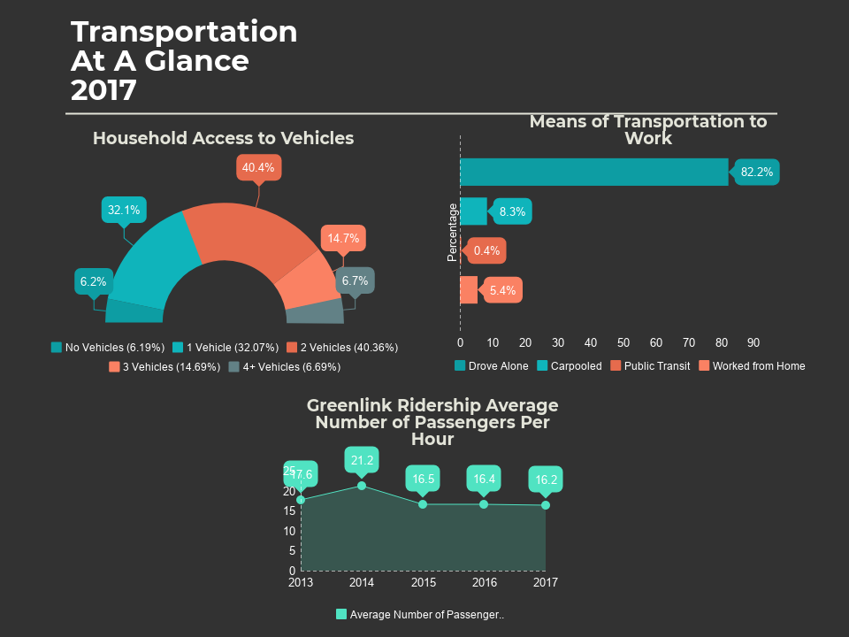

Slide 102
A household’s access to one or more vehicles does not necessarily show access to transportation.
Census counts all vehicles regardless of condition and affordability to own (insurance, gas, tax/title).
Notes:
72.5% of households in Greenville County have access to 1-2 vehicles in 2017. Since 2013, there has been little change in the percentage of household's access to vehicles.
Source: United States Census Bureau, 2013-2017

Slide 103
Notes:
The percentage of individuals in Greenville County who drive alone has slightly decreased from 2013 to 2017 and the percentage who are working form home has increased. Additionally, while there was a decrease from 2016 to 2017, over the past 5 years, the percentage of individuals carpooling has increased.
Only 0.4% of the population used public transit in 2017. Using the 2017 population estimate of 506,837, this equates to approximately 20,273 individuals.
Source: United States Census Bureau, 2013-2017

Slide 104
Number of vehicles operated in maximum service does not include on demand vehicles.
Notes:
Greenlink has had little change in the past 5 years in the number of vehicles available for maximum service and number operated in maximum service, but there has been a slight reduction in the average passengers per hour. This reflect the decrease in percentage for public transit observed in the mode of transportation graph on the previous slide.
Source: United States Department of Transportation, Federal Transit Administration, 2013-2017

